Slide 1

You enter a new location.

Slide 2
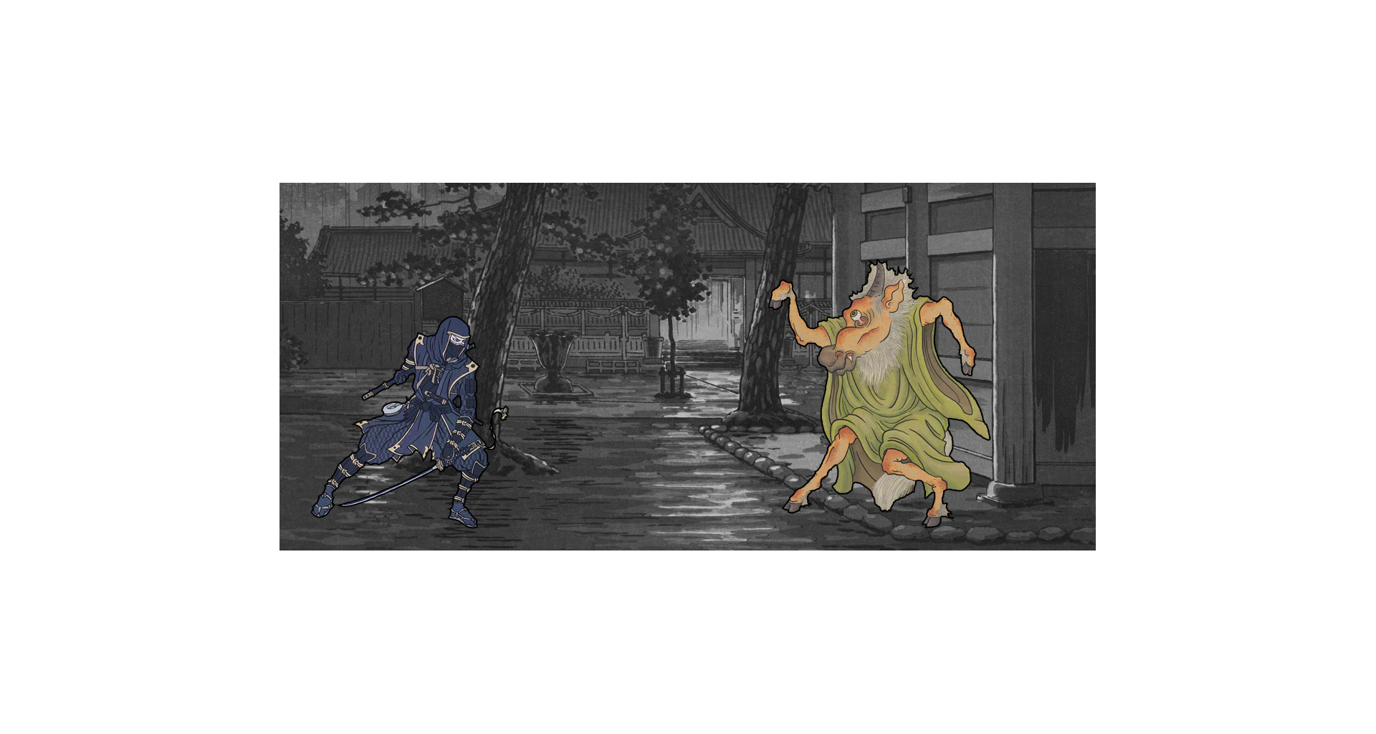
A monster appears: It either attacks or defends.

Slide 3
If it defends: You get to attack first.

Slide 4
If it attacks: You have to parry before it’s your turn.

Slide 5
Monsters have up to three different attacks.

Slide 6
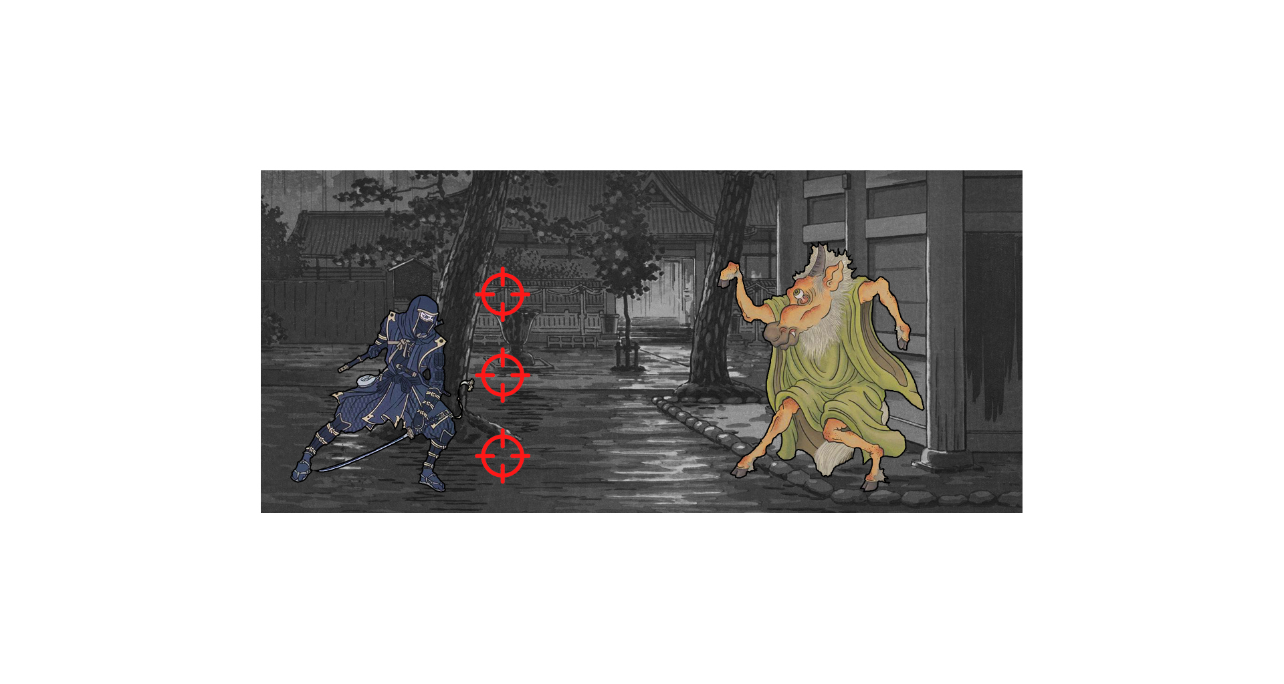
An attack aims either high, low or mid.

Slide 7
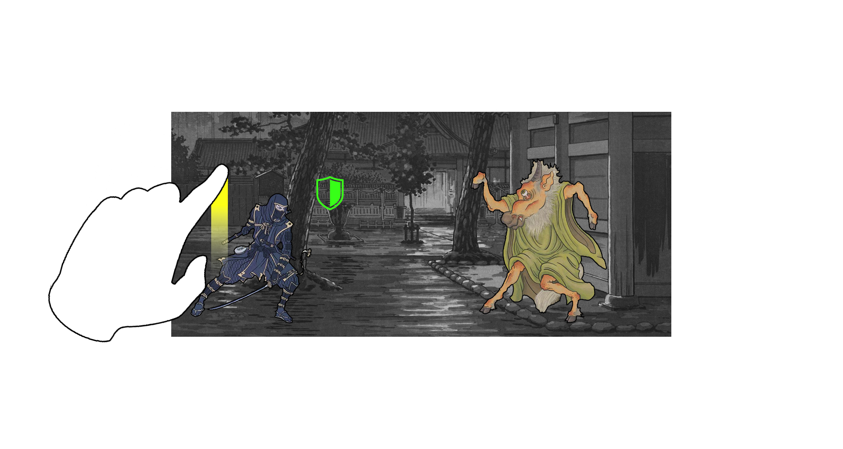
Swipe up to parry high.

Slide 8
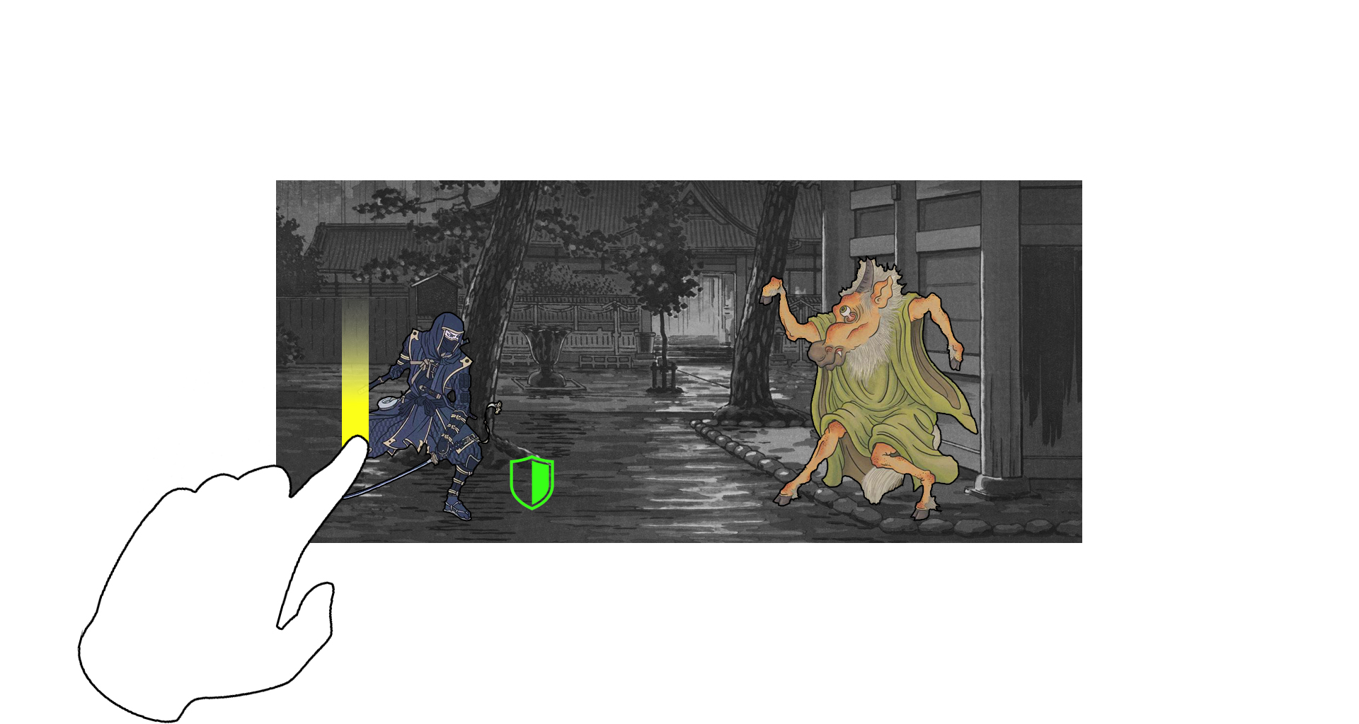
Swipe down to parry low.

Slide 9
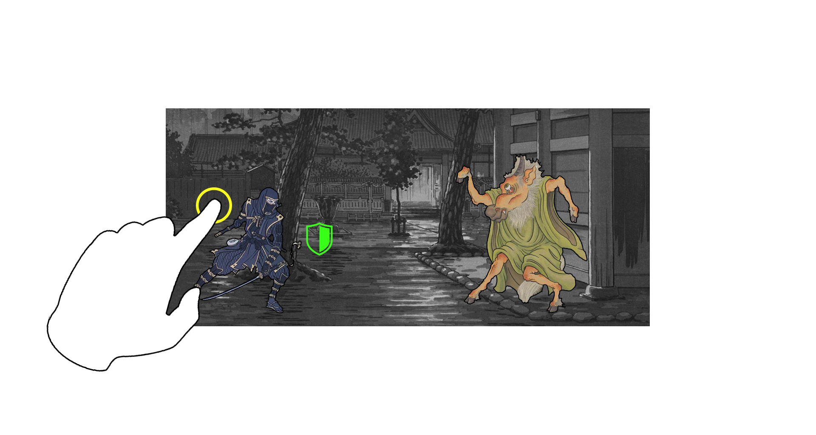
And simply tap to parry center.

Slide 10
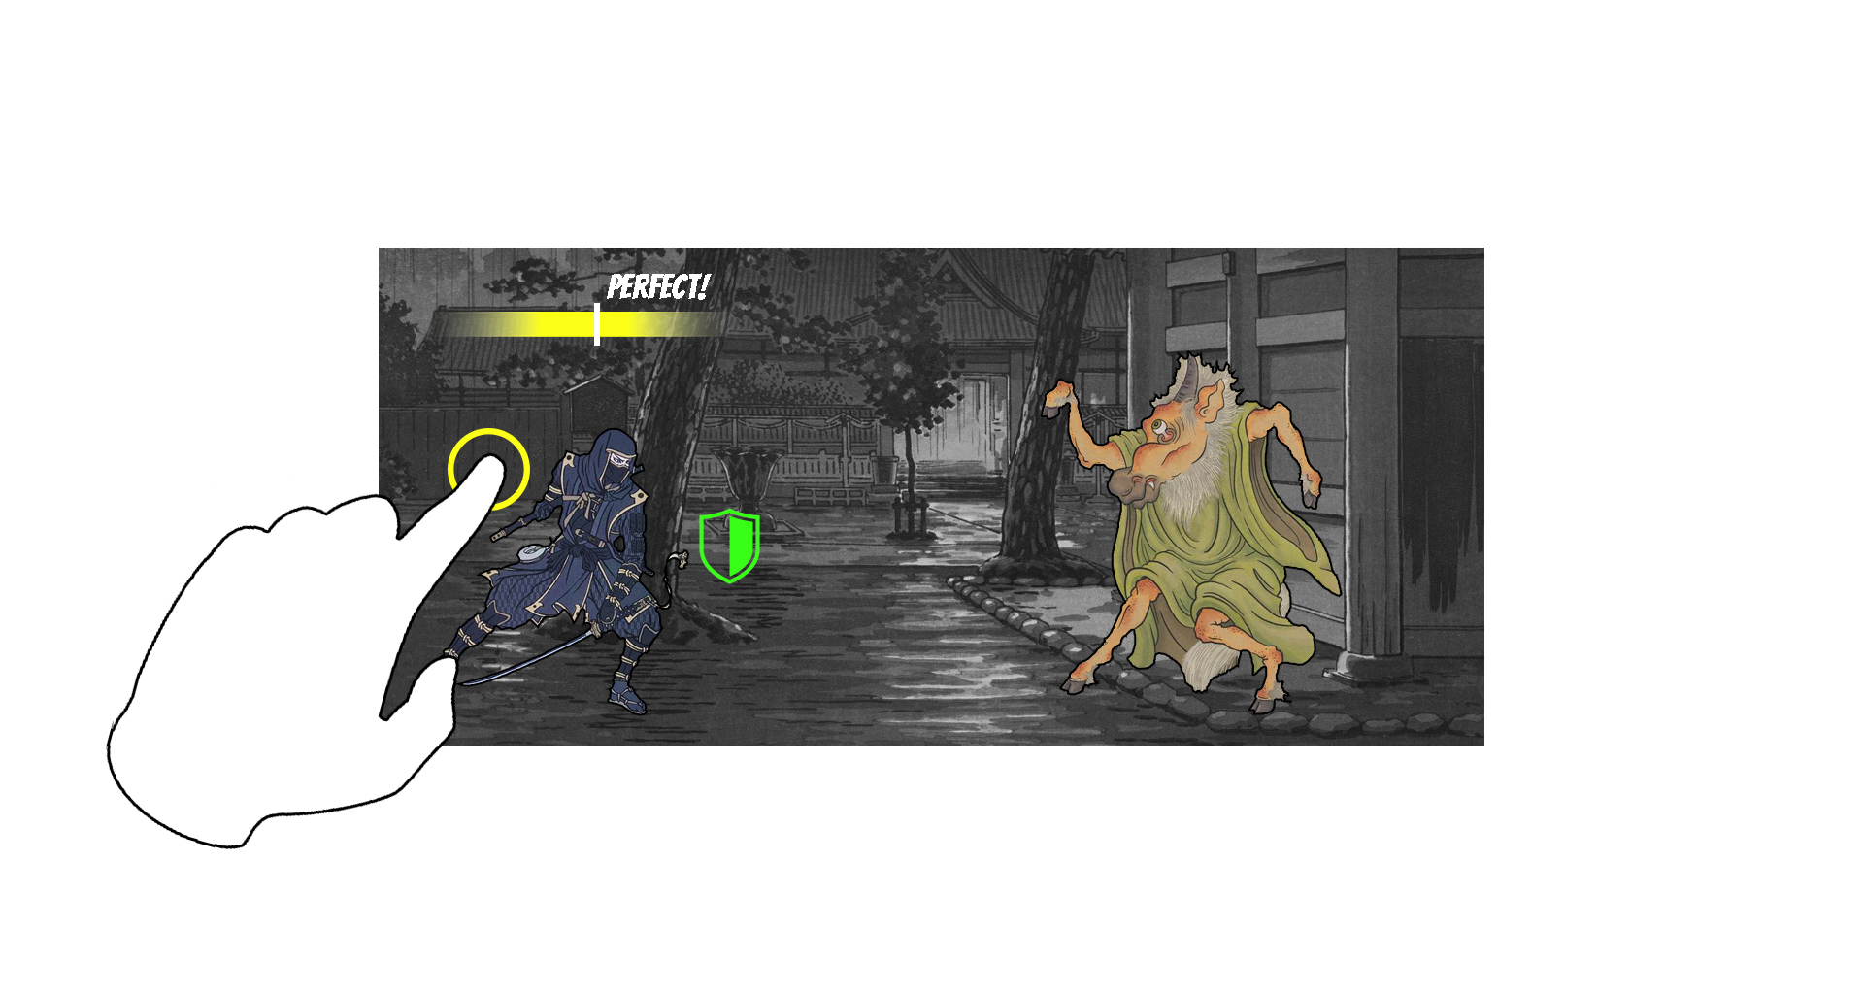
Parries must happen within a certain time frame

Slide 11
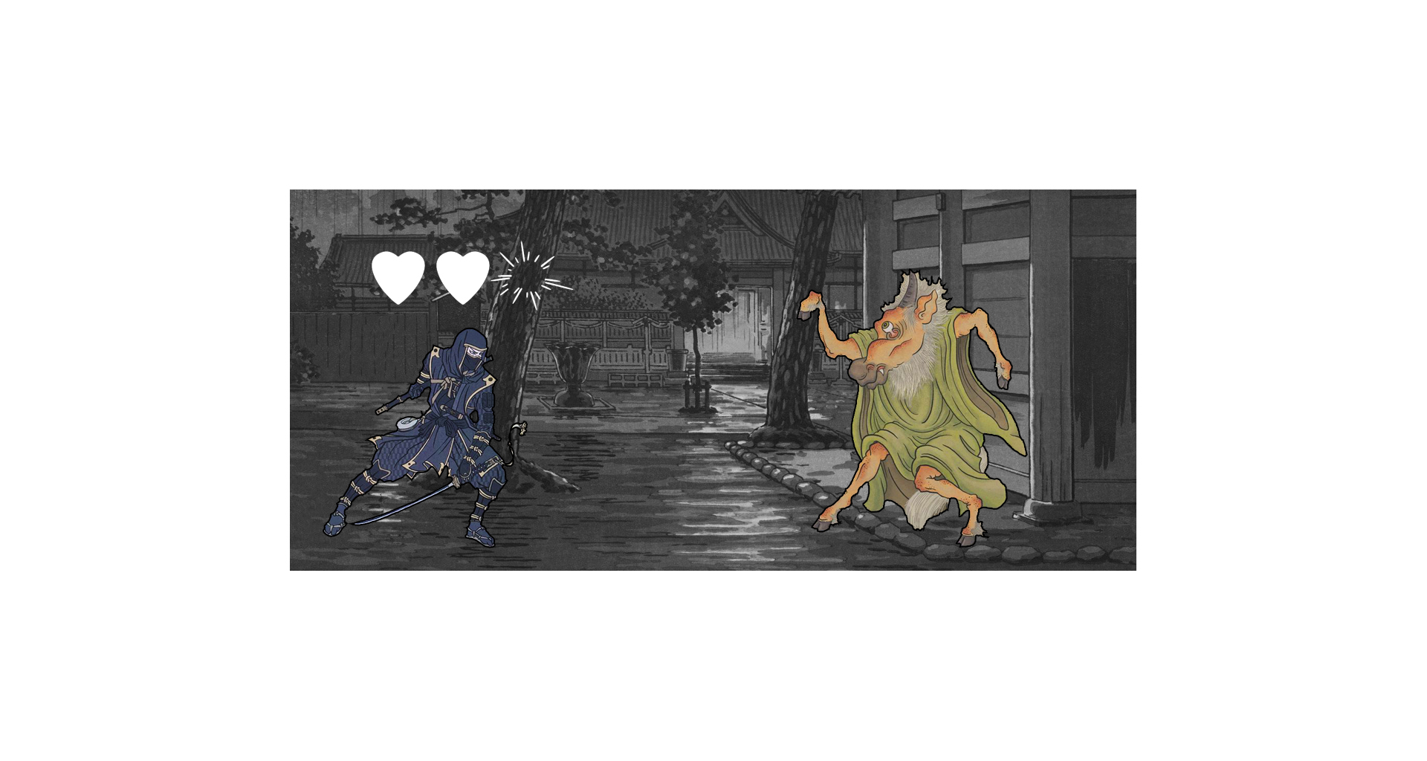
If you fail, you loose health.

Slide 12
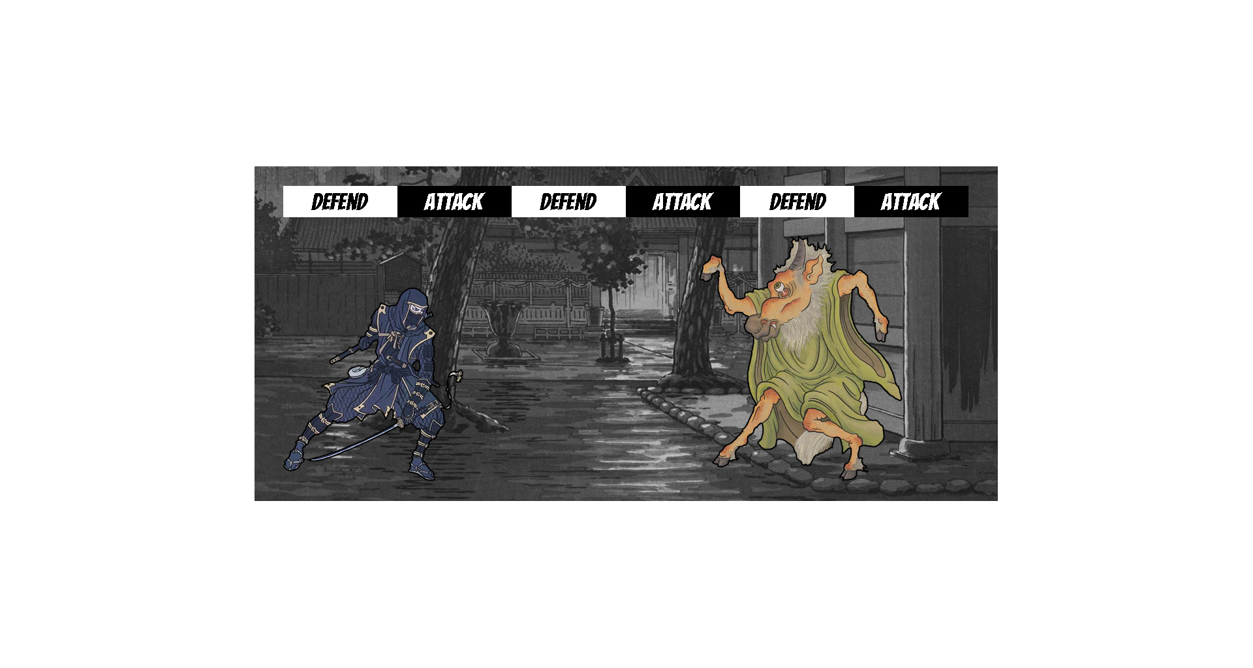
The monster switches from attack to defend

Slide 13
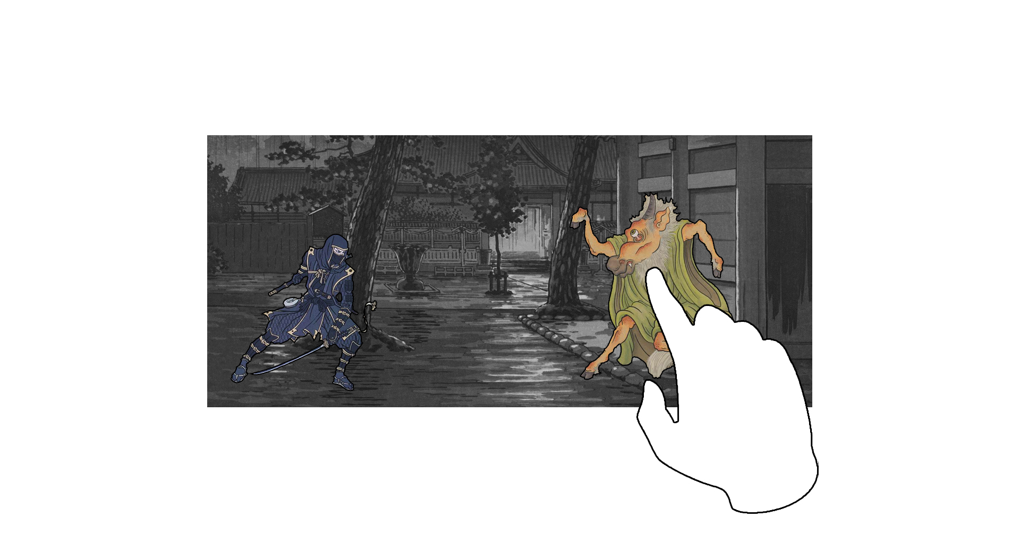
Now you attack: Do a combo of three swipes.

Slide 14
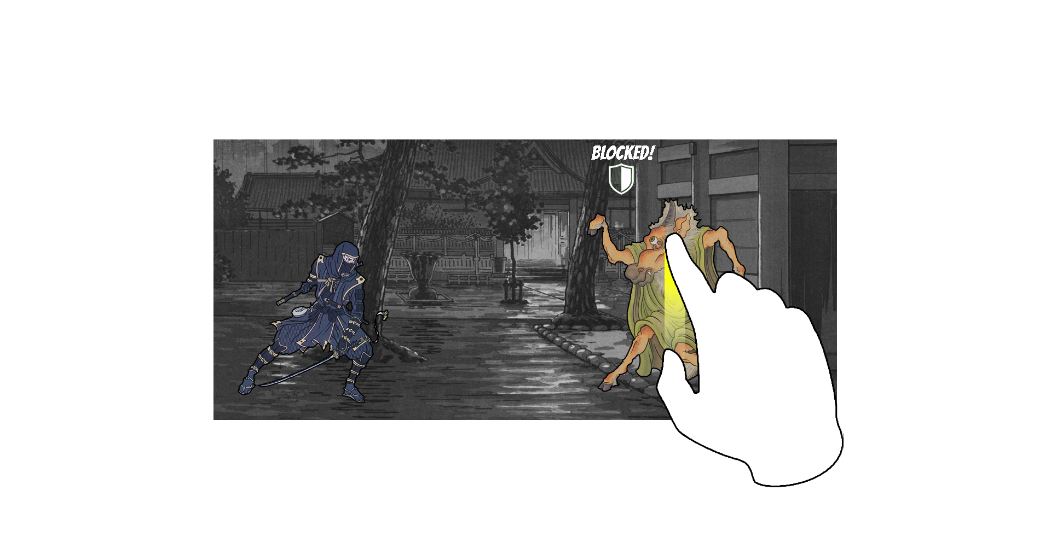
The monster will either block the attack..

Slide 15
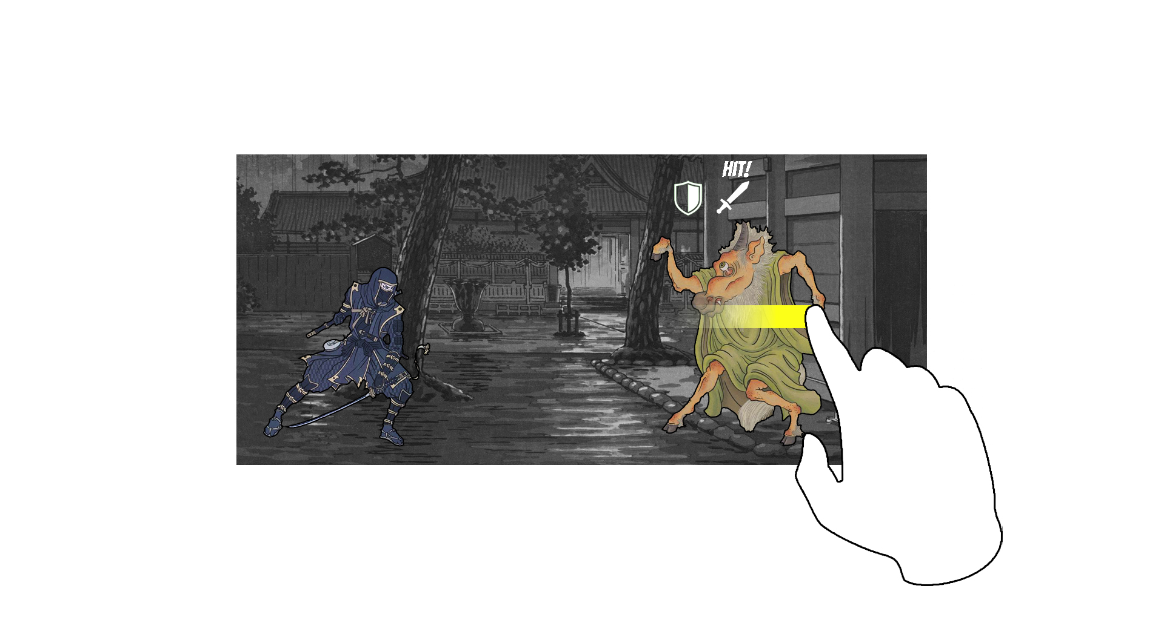
…or take a hit, depending on how you swipe…

Slide 16
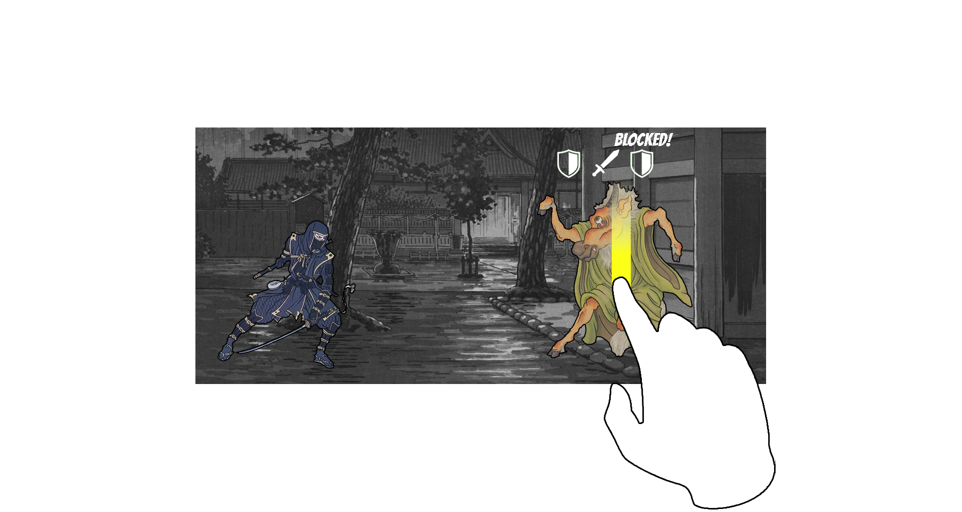
..and when. Find the right combination.

Slide 17
Every monster has its own kill combo. Learn it.

Slide 18
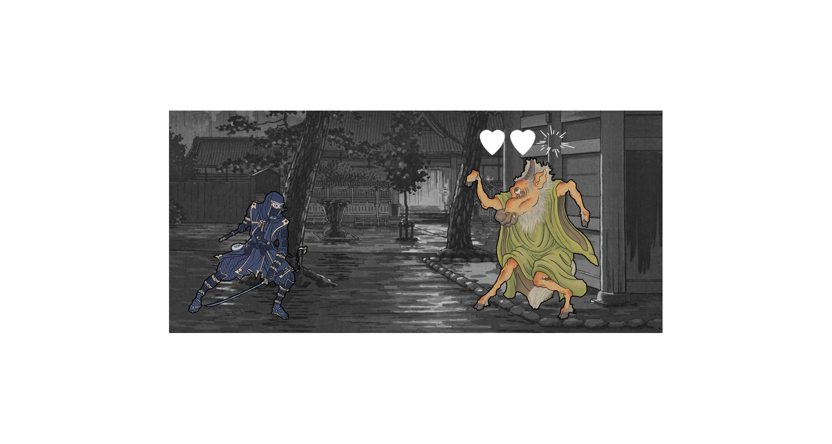
Now, it’s the monster’s turn to loose health.

Slide 19
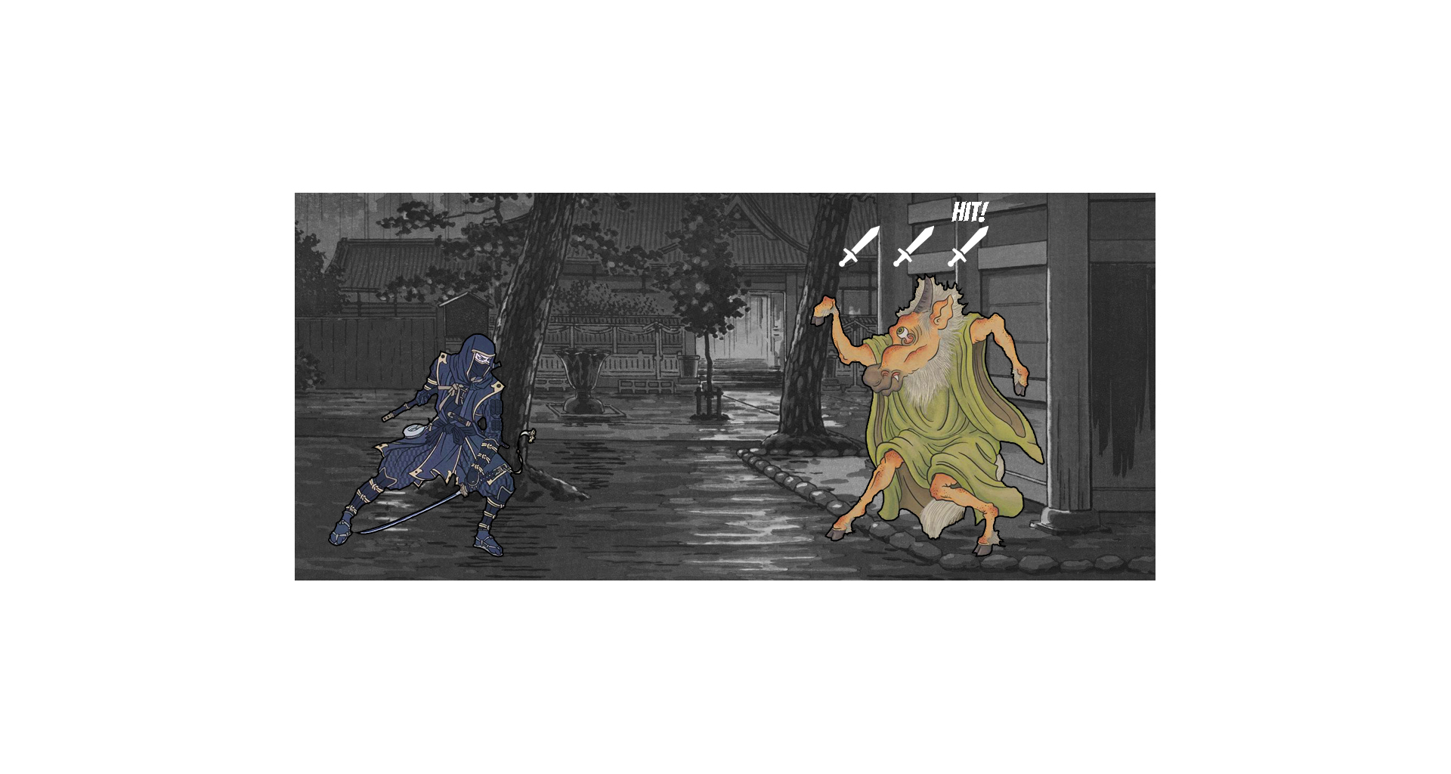
Get the right combo in a single turn to score an
Instakill!

Slide 20
Kill monsters as fast as possible to score points.

